Slide 1
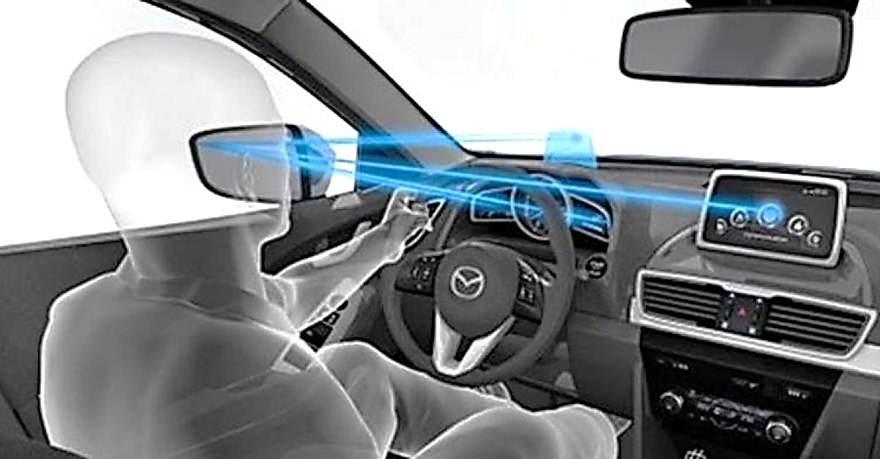
a study of eye movement patterns for distracted driving Capstone Project – MS in Data Analytics Oct 14th, 2017
Shantanu Neema
Neha Dhaliwal
Advisor: Dr. Dvijesh Shastri

Slide 2
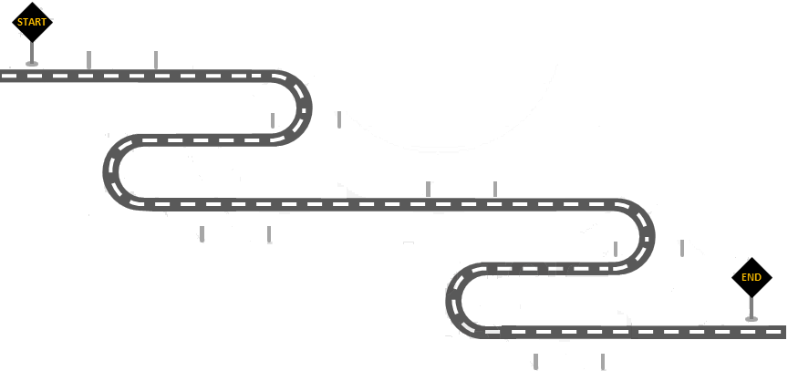
Roadmap
Introduction
Objective
Related Work
Introduction
Experimental Design
Methodology
Data Preprocessing
Experimental Results
Conclusions

Slide 3
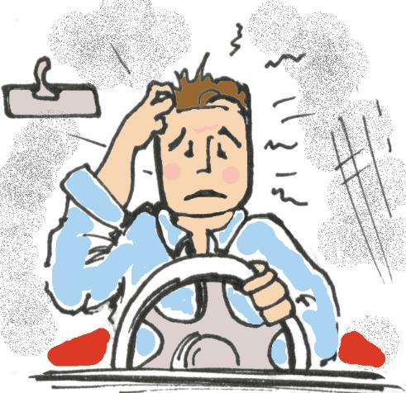
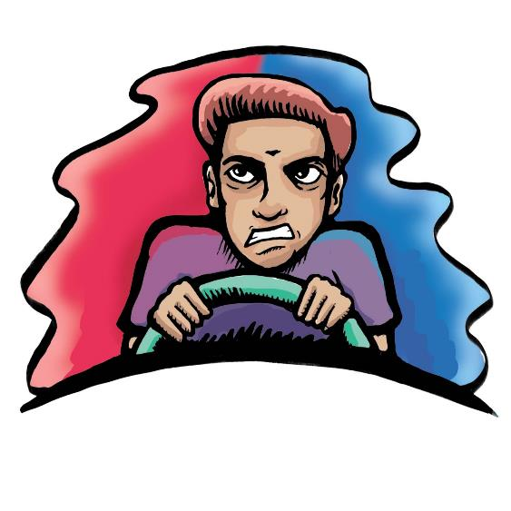
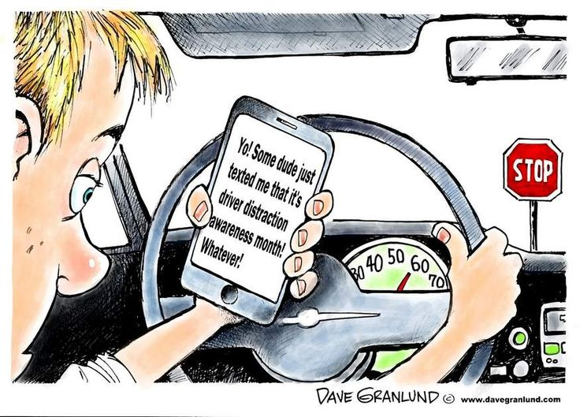
Objective
To understand how distracted driving affects eye movement patterns
Distracted driving: cognitive, emotional, and texting

Slide 4
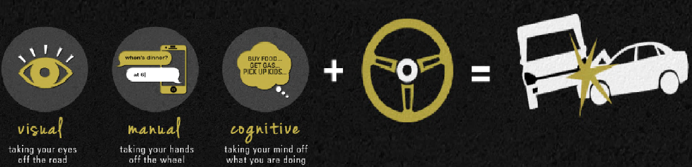
Motivation
Between 13% and 50% of crashes are attributed to driver distraction estimated to cause about 5000 deaths per year^{[1]}
Driving under cognitive distractions can degrade driving performance^{[2]}
Using a cell phone reduces brain activity by 37%^{[3]}
Traffic regulations give no consideration to cognitive and emotional distractions while driving due to lack of clearly abstracted studies^{[4]}
[1] Liang Y., Reyes M.L., Lee J.D., Real-Time Detection of Driver Cognitive Distraction Using Support Vector Machines (June 2007)
[2] Strayer D.L. et al. Measuring cognitive distractions in the Automobile (2013)
[3]/Image Source: https://www.i-lawsuit.com/distracted-driving-is-worse-than-driving-drunk/
[4] Pavlidis et. al, Dissecting Driver Behaviors Under Cognitive, Emotional, Sensorimotor, and Mixed Sensors, pp. 10 (Jan 2016)

Slide 5
Related Work
Past research
Eye movement patterns are correlated with driving performance^{[5]}
Eye glance behavior while texting decreases driving performance^{[6]}
Significant increase in absolute steering was detected in distracted driving^{[4]}
Data mining algorithms can predict cognitive distractions while driving^{[1]}
Scope of our project
Visual analytics of eye movement patterns for distracted driving (cognitive, emotional and texting)
Verify visual analytics using statistical analysis
[1] Liang Y., Reyes M.L., Lee J.D., Real-Time Detection of Driver Cognitive Distraction Using Support Vector Machines (June 2007)
[4] Pavlidis et. al, Dissecting Driver Behaviors Under Cognitive, Emotional, Sensorimotor, and Mixed Sensors, pp. 10 (Jan 2016)
[5] Bian Z. et al. Eye Movement Patterns and Driving Performance (June 2011)
[6] Young K. L., Effects of Phone type on Driving and Eye Glance Behavior while text-messaging (Mar 2014)

Slide 6
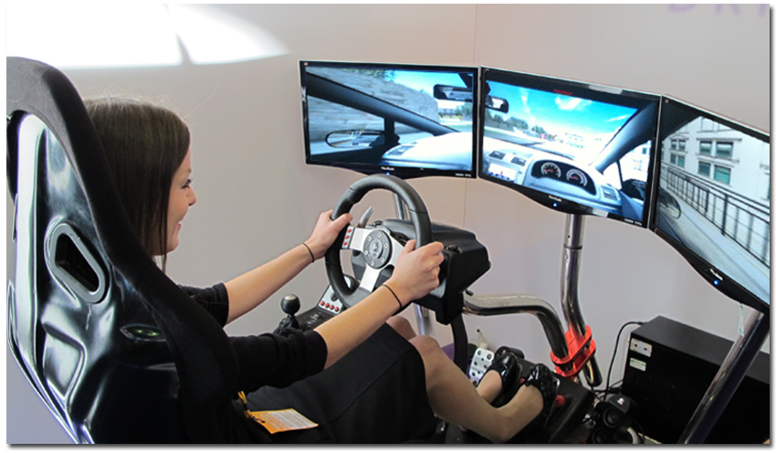

Eye Tracking Technology
A widely used technology to study cognitive processes that effect behavior
An unobtrusive way to gain deeper understanding of mental processes
FOVIO / EyeWorks™, Realtime Technologies have developed advanced simulators

Slide 7
Roadmap
Introduction
Experimental Design
Simulated driving
Experimental protocol
Experimental Design
Methodology
Data Preprocessing
Experimental Results
Conclusion

Slide 8
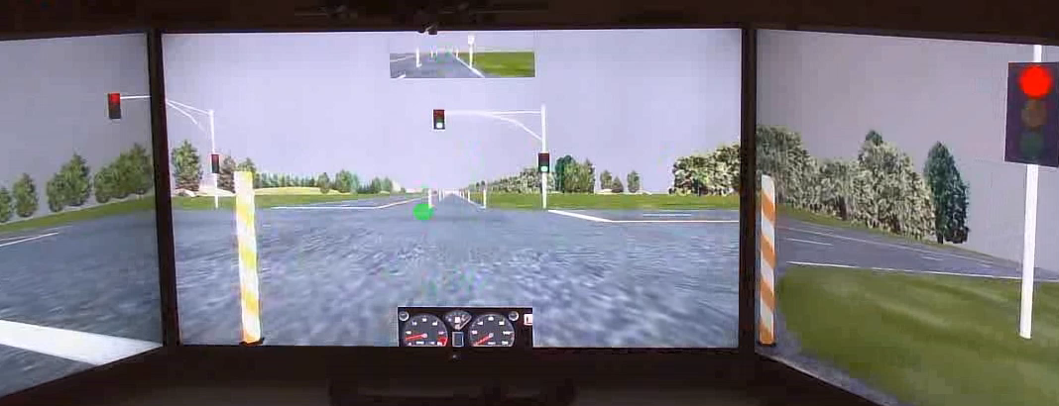
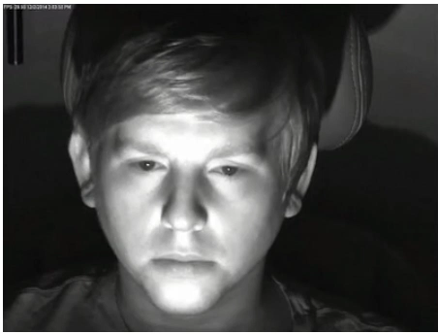
Simulated Driving Setup
No cars to follow, only oncoming traffic
No traffic lights or stop signs
Posted speed limit of 45 mph, 12-14 min drive per participant
Day light setup
Green dot represents eye gaze location
Video Source: http://subjectbook.times.uh.edu/showStudySkipTop/23#

Slide 9
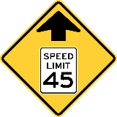
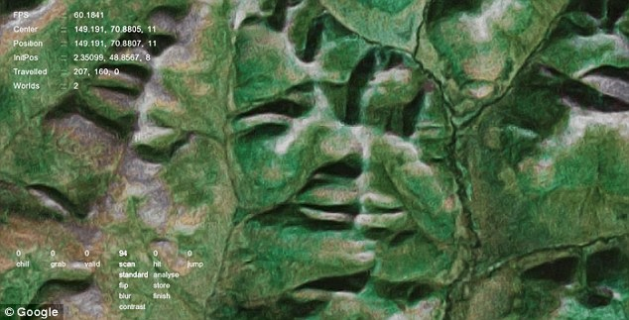


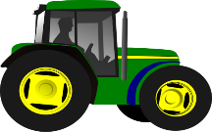
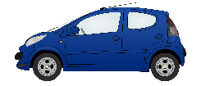

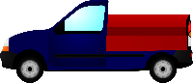

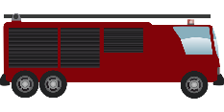
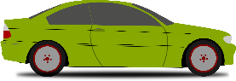
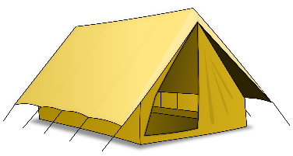

Driving Simulator Track
~ 11 km (12-14 mins)
1.2 km
4.4 km
Distraction
Section II
Distraction
Section I
~120 sec
~160 sec
~240 sec
~160 sec
~80 sec
Normal Drive
2 minutes break
Distracted Drives (separated by 2 min break)

Slide 10
Secondary Activity
Drive Type | Delivery Method | Secondary Activity*
 |  | Section I (~160 sec) | Section II (~160 sec)
Normal | None | - | -
Cognitive | Experimenter asked questions | Analytical Questions - How will you spell 'Simultaneously'? - What are the differences between College Station and Houston? - Why is Texas hotter than California? - What are the differences between a cat and a dog? | Mathematical Questions - What is sum of 74 and 78? - What is 3 times 36? - what is 4 times 70? - what is 54 plus 23?
Emotional |  | Emotional Questions - Do you have children? - How a baby cry makes you feel? - At any time did you find yourself angry and realized it was your fault? - What is the little white lie you told someone? | Emotional Questions - Have you been to Asia before? - Do you like hamburgers? - Do you have a bank account? - What makes you most sad?
Sensorimotor | Text message on smartphone | Reply with a copy of word sent to participant as a text message | Reply with a copy of word sent to participant as a text message
*Random switch between Section I and Section II
Source: http://subjectbook.times.uh.edu/showStudySkipTop/23#

Slide 11
Roadmap
Introduction
Experimental Design
Methodology
Data Preprocessing
Data Preprocessing
Experimental Results
Raw data
Data restructuring
Conclusion

Slide 12




Data Collection and Data Storage
Data collected at Texas A & M Transportation Institute
Using simulator developed by Realtime Technologies
Data is made available by Computational Physiology Laboratory
(www.cpl.uh.edu)

Slide 13
Data Restructuring
Stimulus onset
Eye gaze data (60 Hz)
Driving performance data (42 Hz)
Texting
Texting
Emotional
Emotional
Cognitive
Cognitive
Texting
Normal
Normal
Emotional
Cognitive
Label Stimuli
Replace 0 by ‘NA’
42 Hz to 60 Hz
(Linear interpolation)
Total number of rows = 60 sps x 760 s x 4 sessions x 26 participants ≈ 4.74M

Slide 14
Roadmap
Introduction
Define key features
Feature extraction
Data down-sampling
Experimental Design
Methodology
Methodology
Data Preprocessing
Experimental Results
Conclusion

Slide 15
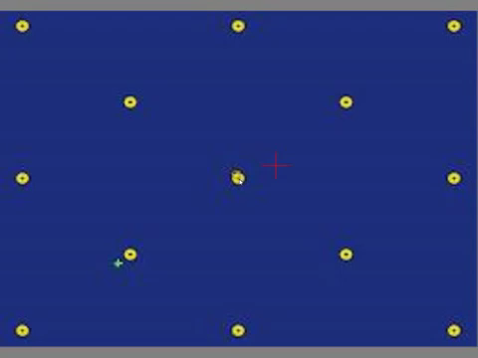

Eye Movement Parameters (1/2)
Fixation Duration
(X₂,Y₂)
d =Saccade distance
(X₁,Y₁)
Saccadic Amplitude
R
Ө
Fixations: An aggregation of gaze points based on aggregation area
Features from fixations:
Gaze location
Fixation duration
Fixation count
Saccades: A rapid eye movement from one fixation to the other
Features from saccades:
Saccadic velocity
Saccade duration

Slide 16
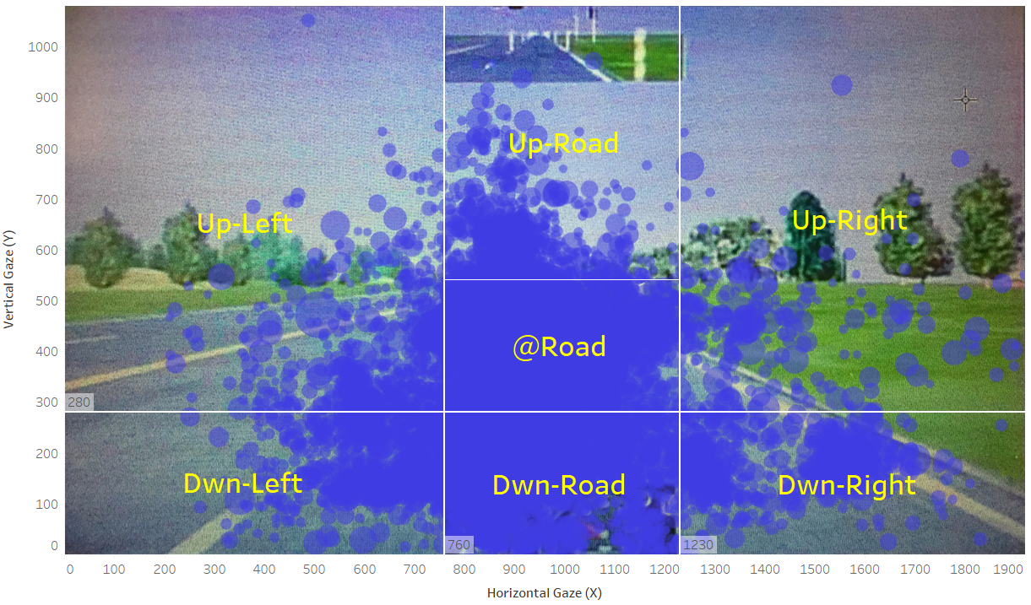
Eye Movement Parameters (2/2)
Areas of Interest (AOI): Regions of high importance for analysis^{[7]}
Features from AOI:
No. of transitions from one AOI to other
Dwell time within AOIs (ms)
Fixations within AOI
[7] Blascheck T at. el, State-of-the-art of Visualization for Eye Tracking Data (2014)

Slide 17
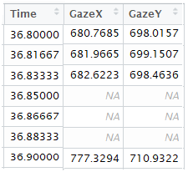
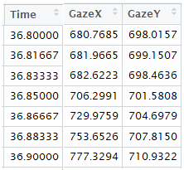
Feature Extraction
Fixation Identification Algorithms^{[8]}
I-VT (Velocity Threshold)
I-HMM (Hidden Markov Model)
I-DT (Dispersion Threshold)
I-MST (Min Spanning Trees)
I-AOI (Area of Interest)
Method | I-DT | I-VT | I-IMM | I-MST | I-AOI
Accuracy | √√ | √ | √√ | √ | ✗
Speed | √ | √√ | √ | ✗ | √
Robustness | √√ | ✗ | √√ | √√ | √
Implementation | √ | √√ | √/✗* | ✗ | √
Parameters | 2 | 1 | 8/0* | 2 | 1
If dispersion of window points
<= threshold (with min Duration)
Dispersion threshold: 20 px
Min fixation duration: 200 ms^{[9]}
Very good accuracy
‘emov’ package in R^{[10]}
Remove missing data
Label each point below velocity threshold as a fixation point, otherwise as a saccade point
Velocity threshold: <100◦/s^{[1]}
Good accuracy
‘saccades’ package in R
Robust and easy to implement
I-DT Algorithm
Fixation & Saccades
*8 parameters without re-estimation, 0 with re-estimation
5 pt smoothing^{[11]}
[8] Salvucci D. D., Goldberg H. J., Identifying Fixation and Saccades in Eye-tracking Protocols, pp. 71-78, ACM Press (2000)
[9] Kapitaniak B. et. al., Application of eye-tracking in drivers testing: a review of research, pp. 941-954,IJOMEH (2015)
[10] Schwab S., Eye Movement Analysis Package for Fixation and Saccade Detection (2016)
[11] Homqvist K., Nystrom M., An adaptive algorithm for fixation, saccade and glissade detection in eyetracking data, pp. 188-204 (2010)

Slide 18
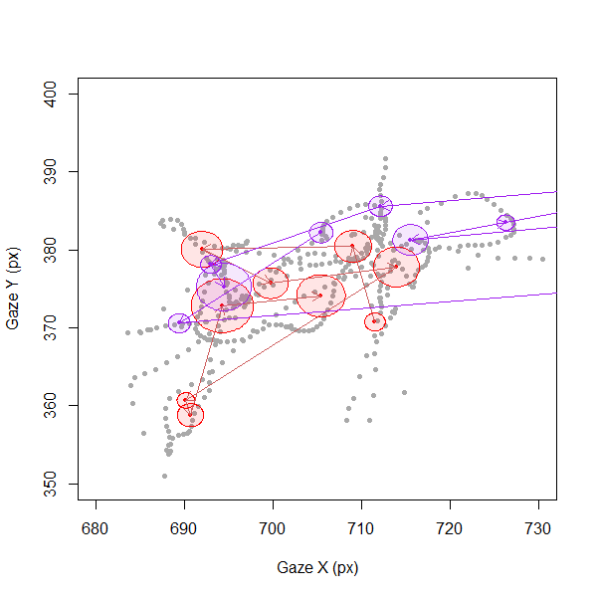
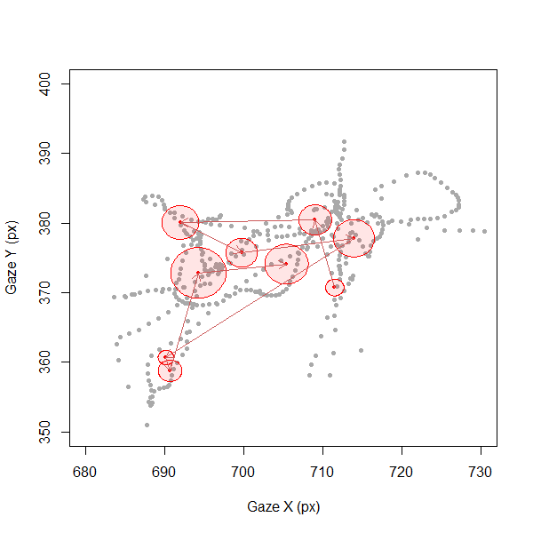
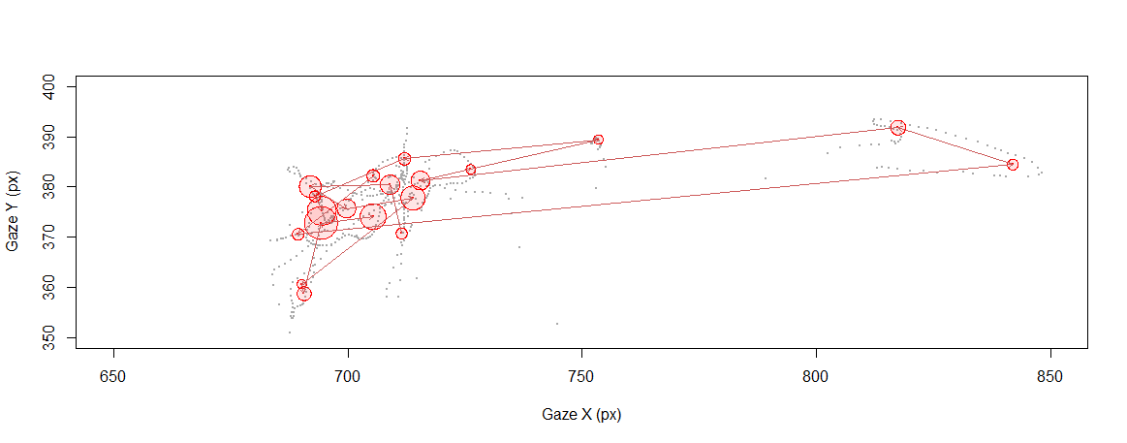
Original Data vs Processed Data
Sample scan-path (10 sec)
Start
End
End
Start

Slide 19
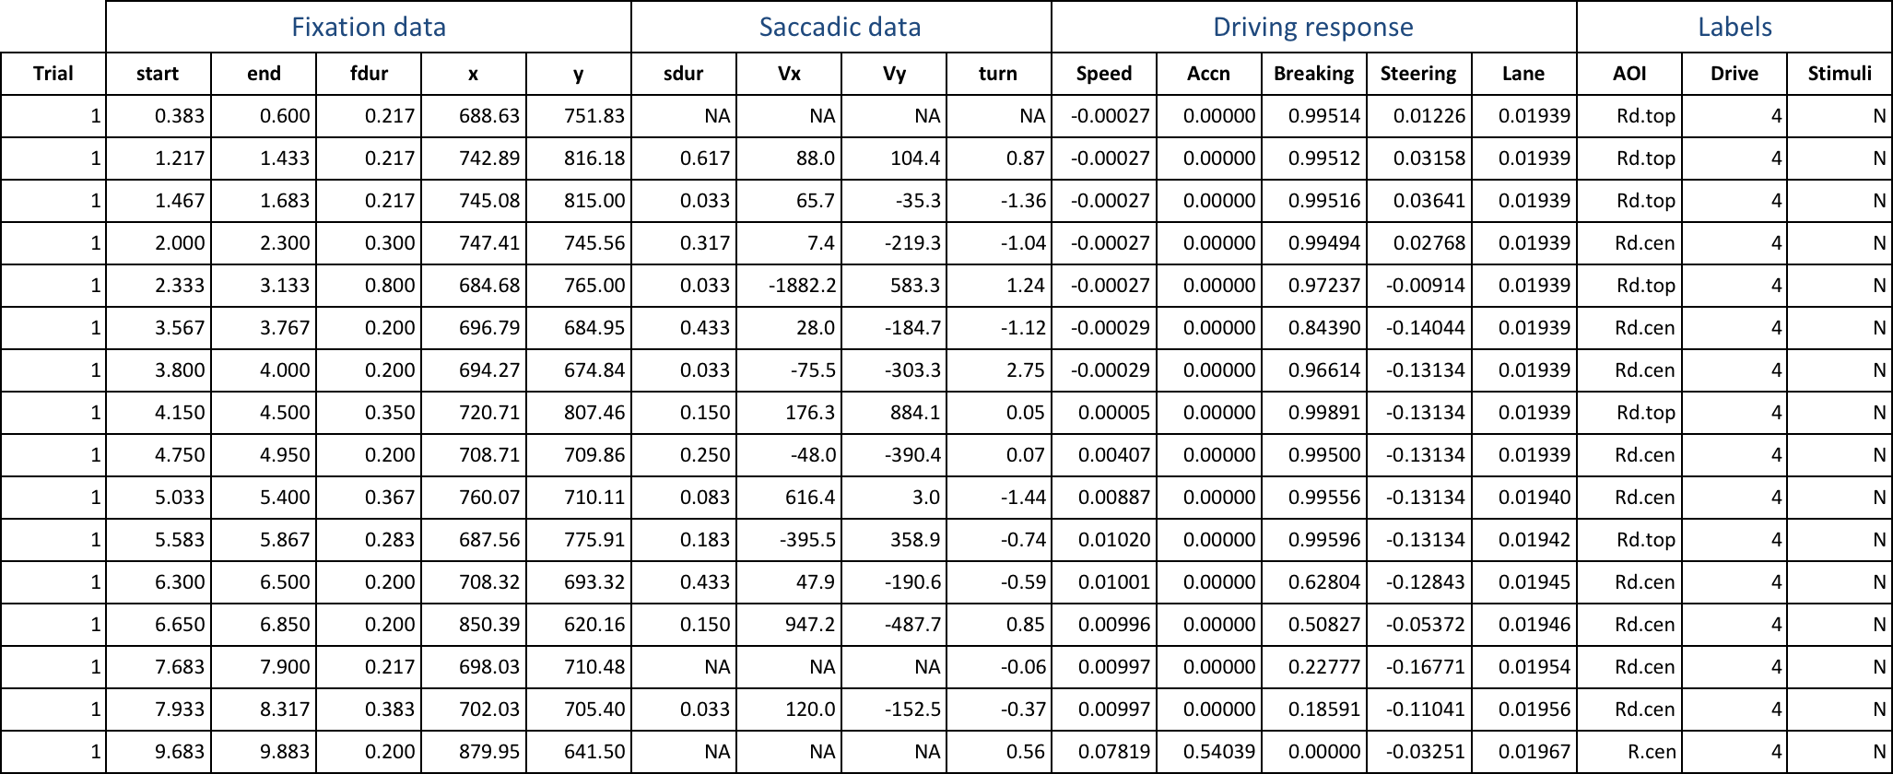
Sample Processed Data
Aggregate driving data for each fixation (mean driving response)
1.6 fixations/s x 760 s x 4 sessions x 26 participants ≈ 0.129M rows of data ≈ 1/38th of original data

Slide 20
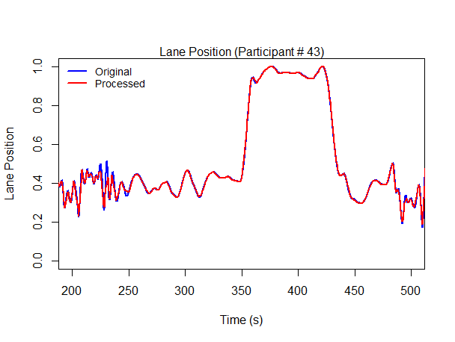
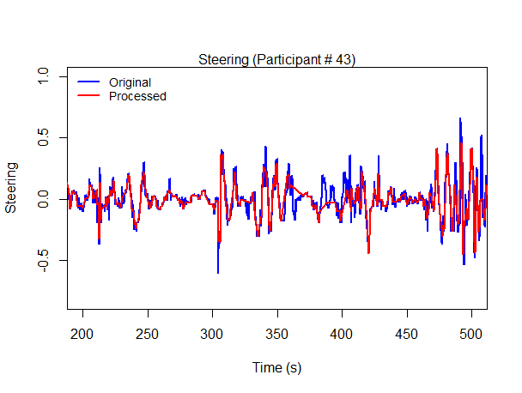
Original Data vs Processed Data (Driving Response)

Slide 21
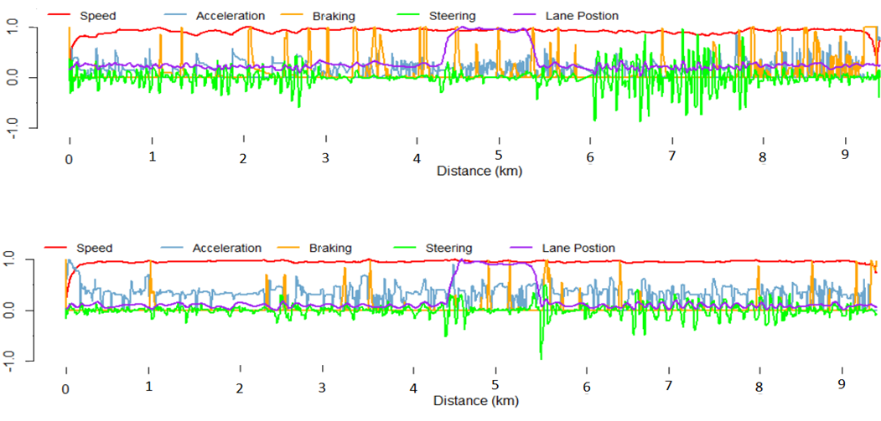
Driving Phases for Data Analysis
Distracted Drive (Emotional Drive, Participant #43)
Section I
Section II
Normal Drive (Participant #43)

Slide 22
Roadmap
Introduction
Visual analysis
Statistical analysis
Clustering
Experimental Design
Methodology
Data Preprocessing
Experimental Results
Experimental Results
Conclusion

Slide 23
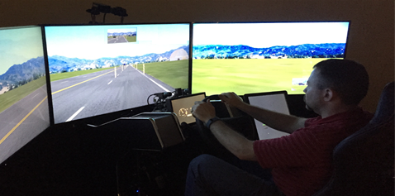
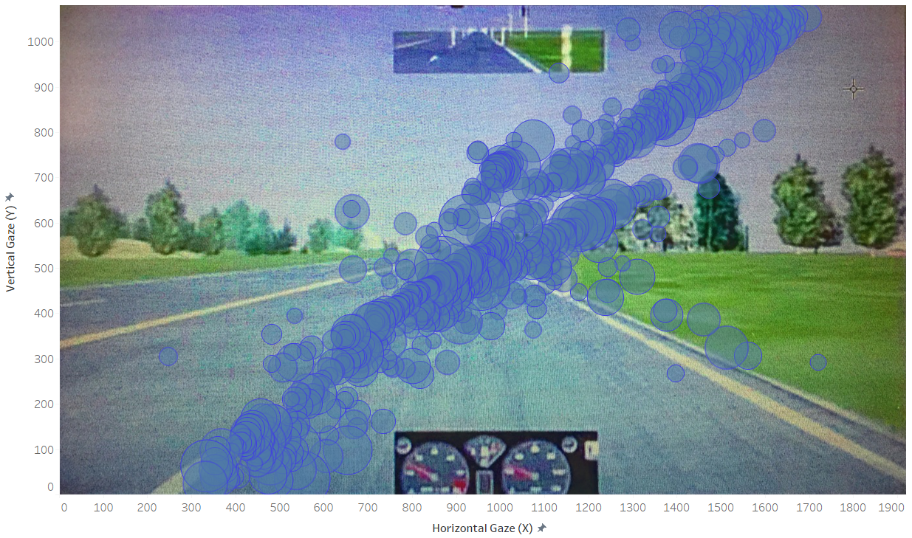
Study Participants
n = 31 participants
Recruited from Bryan and College Station, TX
Valid driver’s license
1.5 years of driving experience
Two practice runs before the actual experiment
5 participants were removed
Excessive amount of missing information (3 participants)
Very different or unexplainable gaze data (might be due to incorrect calibration, 2 participants)

Slide 24
Biographic Information and Personality Traits
Type A > 207
(Aggressive)^{[12]}
Score > 30
(Anxious)^{[13]}
[12] Jenkins C.D. et. al., N.Y.P Jenkins activity survey (1979)
[13] Spielberger C.D., State-Trait Anxiety Inventory (2010)

Slide 25
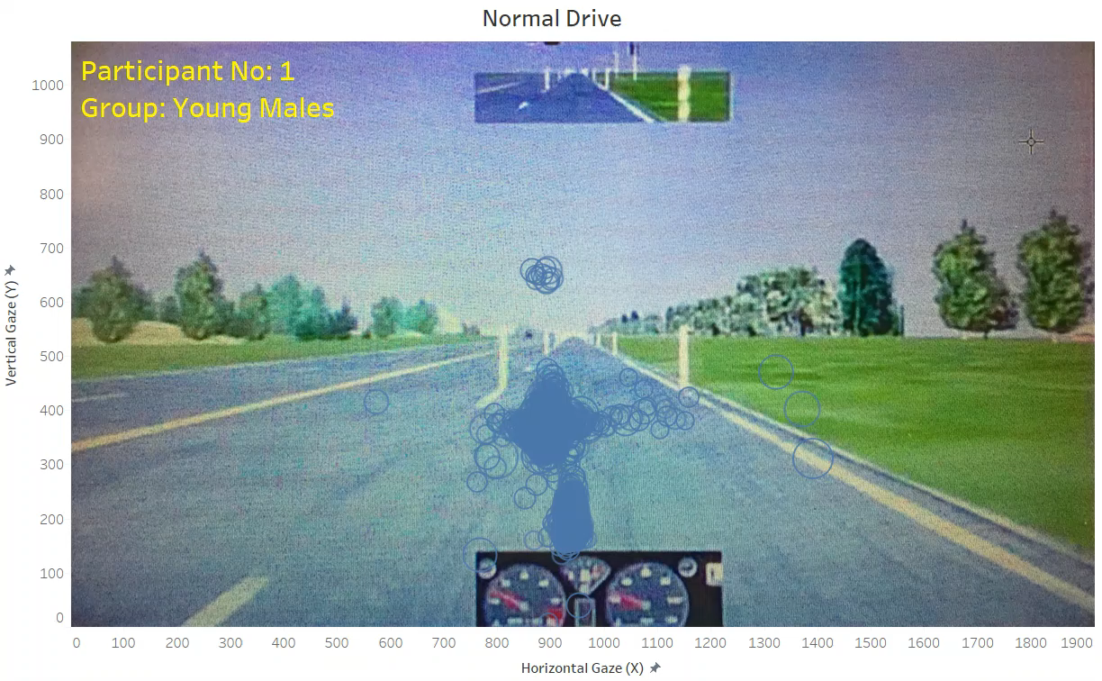
Tableau Visualization (Fixation Patterns)
Normal Drive
Normal Drive
Focus at the Road
Too few fixations in rear view mirror
More variability of fixations for older participants

Slide 26
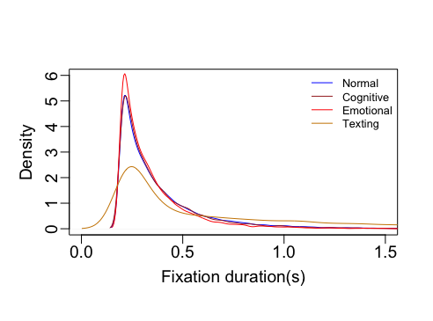
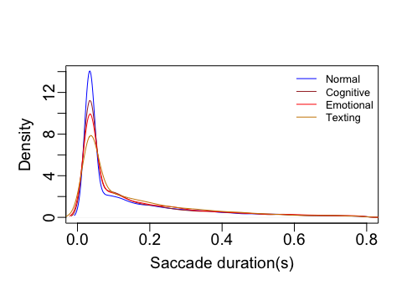
Data Distributions
Density plots
Observations
Data is right skewed
Transformations to be applied:
- Log
- SQRT

Slide 27
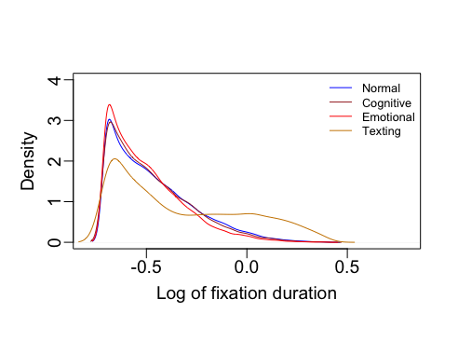
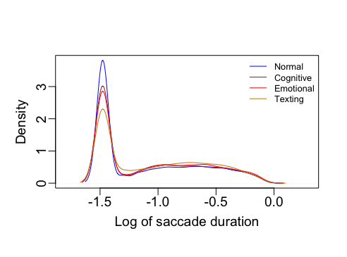
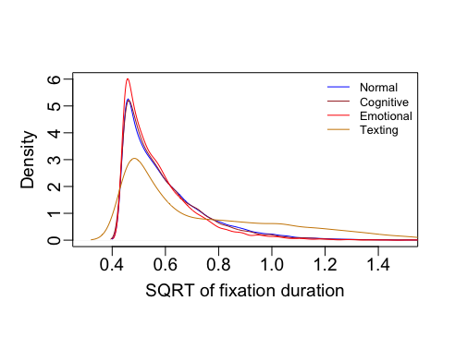
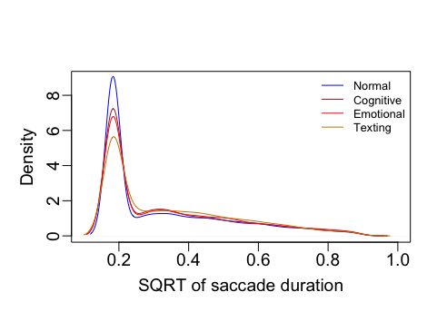
Transformations
Density plots
Logarithmic
Square-root

Slide 28
Applicable Statistical Tests
Consequences: Following tests cannot be applied to skewed distributions
t-test (normal distribution assumption violation)
ANOVA (normal distribution assumption violation)
Resolution: Non-parametric hypothesis tests
Wilcoxon test (an alternative to t-test)
Kruskal-Wallis (an alternative to ANOVA)
Other tests
Kolmogorov–Smirnov: To compare fixation and saccade duration distribution
Chi-squared goodness of fit: To compare frequencies (Fixations count)

Slide 29
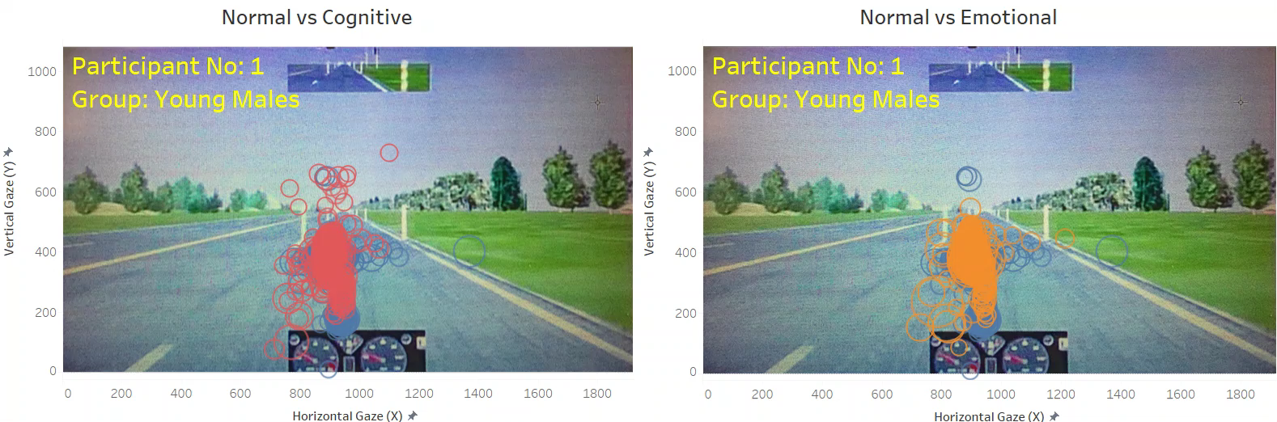
In comparison to normal driving, most participants have fixations in narrower range for cognitive and emotional stimuli
Fixation Comparison (Cognitive/Emotional)
Normal
Cognitive
Emotional

Slide 30
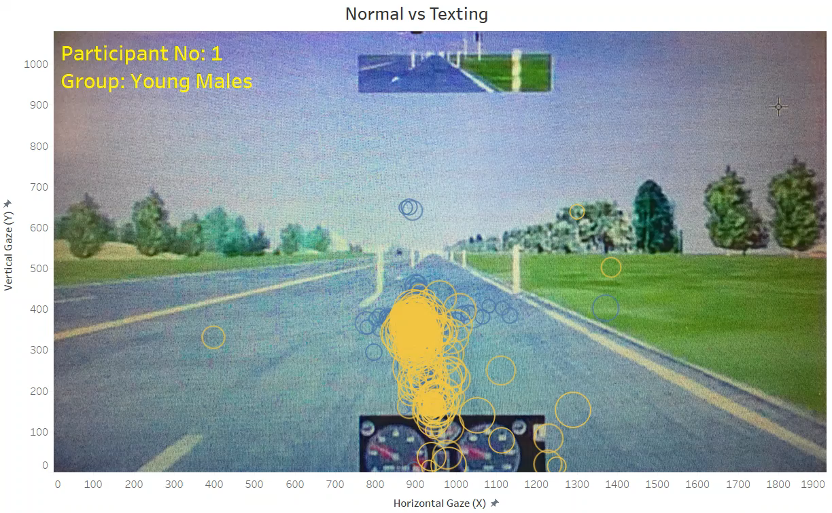
In comparison to normal driving, most participants’ display wider range of fixations in vertical direction
Fixation Comparison (Texting)
Normal
Texting

Slide 31
Fixation Count
Observation
Number of fixations decreases for texting
Chi-Square (p-values)
 | Normal | Cognitive | Emotional | Texting
Normal | - | - | - | -
Cognitive | 0.645 | - | - | -
Emotional | 0.556 | 0.446 | - | -
Texting | 0.000 | 0.000 | 0.000 | -
Fixation count

Slide 32
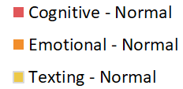
Percentage Change in Fixation Count
Observations
Older males show an increase in percentage fixation counts when driving under cognitive or emotional distraction
The percentage fixation counts decrease when a person is texting
% change in fixation counts
% change in fixation counts
% change in fixation counts

Slide 33
Fixation Counts
Fixation counts
Fixation duration (ms)

Slide 34
Fixation/saccade/AOI analysis
Tableau Visualizations

Slide 35
Fixation Duration (Gender and Age Analysis)
Kolmogorov–Smirnov (Distribution comparison)
Wilcoxon (Median comparison)
Observation
Males tend to have significantly different fixation distributions for cognitive distractions
Participant | Normal vs Congnitive | Normal vs Emotional | Normal vs Texting
1 | 0.000 | 0.001 | 0.000
5 | 0.034 | 0.434 | 0.000
9 | 0.000 | 0.043 | 0.000
13 | 0.000 | 0.000 | 0.000
19 | 0.000 | 0.351 | 0.000
21 | 0.004 | 0.000 | 0.000
4 | 0.379 | 0.266 | 0.000
6 | 0.000 | 0.001 | 0.000
10 | 0.829 | 0.480 | 0.601
12 | 0.038 | 0.000 | 0.000
14 | 0.000 | 0.006 | 0.000
16 | 0.112 | 0.593 | 0.000
20 | 0.058 | 0.000 | 0.000
22 | 0.000 | 0.292 | 0.000
24 | 0.449 | 0.081 | 0.000
44 | 0.082 | 0.021 | 0.000
46 | 0.979 | 0.141 | 0.000
50 | 0.000 | 0.000 | 0.000
51 | 0.000 | 0.000 | 0.000
54 | 0.000 | 0.000 | 0.000
25 | 0.028 | 0.387 | 0.000
33 | 0.000 | 0.000 | 0.004
35 | 0.103 | 0.073 | 0.000
39 | 0.000 | 0.243 | 0.000
41 | 0.894 | 0.640 | 0.000
43 | 0.000 | 0.007 | 0.000
Summary | 19/26 | 16/26 | 25/26
Participant | Normal vs Congnitive | Normal vs Emotional | Normal vs Texting
1 | 0.000 | 0.000 | 0.000
5 | 0.002 | 0.421 | 0.000
9 | 0.000 | 0.125 | 0.000
13 | 0.000 | 0.000 | 0.000
19 | 0.000 | 0.342 | 0.000
21 | 0.014 | 0.000 | 0.000
4 | 0.224 | 0.773 | 0.000
6 | 0.000 | 0.001 | 0.000
10 | 0.618 | 0.258 | 0.744
12 | 0.016 | 0.000 | 0.000
14 | 0.000 | 0.000 | 0.000
16 | 0.129 | 0.577 | 0.000
20 | 0.016 | 0.000 | 0.040
22 | 0.000 | 0.108 | 0.000
24 | 0.097 | 0.016 | 0.000
44 | 0.172 | 0.173 | 0.001
46 | 0.989 | 0.740 | 0.000
50 | 0.000 | 0.000 | 0.001
51 | 0.000 | 0.000 | 0.014
54 | 0.000 | 0.000 | 0.000
25 | 0.162 | 0.658 | 0.000
33 | 0.000 | 0.000 | 0.064
35 | 0.371 | 0.175 | 0.000
39 | 0.000 | 0.558 | 0.000
41 | 0.786 | 0.380 | 0.000
43 | 0.000 | 0.005 | 0.000
Summary | 18/26 | 13/26 | 25/26
Young
Old
Male
Female
p-value ≤ 0.01
0.01 < p-value ≤ 0.05
0.05 < p-value ≤ 0.10

Slide 36
Saccade Duration (Gender and Age Analysis)
Kolmogorov–Smirnov (Distribution comparison)
Wilcoxon (Median comparison)
Observation
Males tend to have significantly different saccade distributions for cognitive and emotional distractions
Participant | Normal vs Congnitive | Normal vs Emotional | Normal vs Texting
1 | 0.021 | 0.002 | 0.198
5 | 0.000 | 0.088 | 0.014
9 | 0.000 | 0.000 | 0.000
13 | 0.000 | 0.000 | 0.000
19 | 0.000 | 0.000 | 0.149
21 | 0.015 | 0.000 | 0.000
4 | 0.018 | 0.535 | 0.009
6 | 0.000 | 0.043 | 0.009
10 | 0.556 | 0.751 | 0.059
12 | 0.460 | 0.000 | 0.000
14 | 0.000 | 0.000 | 0.028
16 | 0.096 | 0.134 | 0.022
20 | 0.000 | 0.000 | 0.000
22 | 0.039 | 0.015 | 0.000
24 | 0.041 | 0.196 | 0.004
44 | 0.000 | 0.170 | 0.700
46 | 0.010 | 0.000 | 0.000
50 | 0.000 | 0.000 | 0.142
51 | 0.049 | 0.021 | 0.029
54 | 0.000 | 0.000 | 0.007
25 | 0.001 | 0.068 | 0.000
33 | 0.000 | 0.000 | 0.015
35 | 0.000 | 0.000 | 0.001
39 | 0.000 | 0.094 | 0.038
41 | 0.765 | 0.061 | 0.586
43 | 0.088 | 0.333 | 0.001
Summary | 23/26 | 20/26 | 21/26
Participant | Normal vs Congnitive | Normal vs Emotional | Normal vs Texting
1 | 0.007 | 0.002 | 0.889
5 | 0.005 | 0.259 | 0.136
9 | 0.000 | 0.000 | 0.000
13 | 0.000 | 0.000 | 0.000
19 | 0.000 | 0.000 | 0.654
21 | 0.032 | 0.001 | 0.000
4 | 0.086 | 0.643 | 0.229
6 | 0.005 | 0.098 | 0.104
10 | 0.838 | 0.772 | 0.044
12 | 0.248 | 0.010 | 0.000
14 | 0.000 | 0.000 | 0.064
16 | 0.254 | 0.242 | 0.026
20 | 0.000 | 0.000 | 0.000
22 | 0.015 | 0.037 | 0.000
24 | 0.029 | 0.040 | 0.340
44 | 0.000 | 0.897 | 0.413
46 | 0.002 | 0.000 | 0.000
50 | 0.000 | 0.000 | 0.071
51 | 0.079 | 0.021 | 0.036
54 | 0.000 | 0.000 | 0.002
25 | 0.342 | 0.946 | 0.000
33 | 0.000 | 0.000 | 0.016
35 | 0.000 | 0.000 | 0.003
39 | 0.078 | 0.858 | 0.232
41 | 0.786 | 0.261 | 0.903
43 | 0.457 | 0.201 | 0.010
Summary | 20/26 | 17/26 | 17/26
Young
Old
Male
Female
p-value ≤ 0.01
0.01 < p-value ≤ 0.05
0.05 < p-value ≤ 0.10

Slide 37
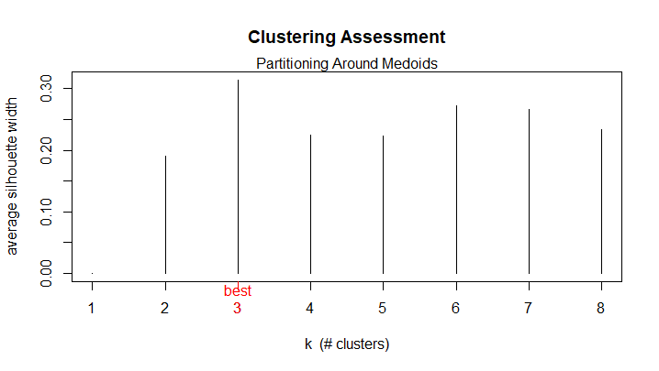
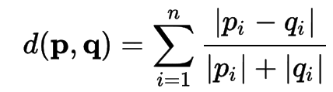
Clustering for Normal Driving
Features
Fixation and saccade durations (Mean and standard deviation)
Location of fixation gazes
Saccade velocities in horizontal and vertical direction
Age, Personality type (A/B) and Trait Anxiety Inventory
Algorithm: Partitioning Around Medoids
Distance as ‘canberra’

Slide 38
Clustering Results
Clusters | No. of Participants | Participant Types | Description
Cluster 1 (YF) | 7 | 6 Young Females, 1 Old Male | Dominant group: Young *Females
Cluster 2 (Mixed) | 12 | 5 Young Males, 1 Old Male, 3 Young Females, 3 Old Females | ~46% drivers, irrespective *of age/gender
Cluster 3 (Old) | 7 | 3 Old Males, 3 Old Females, 1 Young Male | Dominant group: Old *Participants
Total | 26 | - | -

Slide 39
Fixation/saccade/AOI analysis on Clusters
Tableau Visualization

Slide 40
Driving Performance 1/2 (Mean Values)
Change in mean lane position
Participant | Cognitive - Normal | Emotional - Normal | Texting - Normal
1 | 0.006 | 0.006 | 0.118
5 | -0.077 | -0.070 | 0.015
9 | -0.029 | -0.053 | -0.002
13 | -0.056 | -0.048 | -0.023
19 | -0.015 | -0.018 | -0.046
21 | 0.004 | 0.013 | 0.022
4 | 0.003 | -0.035 | 0.058
6 | 0.031 | 0.000 | -0.023
10 | -0.079 | -0.042 | 0.055
12 | -0.019 | -0.026 | 0.056
14 | -0.020 | -0.006 | 0.027
16 | 0.003 | 0.008 | 0.051
20 | -0.012 | 0.040 | 0.132
22 | 0.032 | -0.012 | 0.024
24 | -0.030 | -0.047 | 0.055
44 | -0.003 | 0.013 | 0.054
46 | -0.034 | -0.064 | 0.120
50 | 0.025 | 0.039 | 0.250
51 | -0.034 | 0.004 | 0.425
54 | 0.005 | 0.000 | 0.037
25 | 0.037 | -0.017 | 0.549
33 | -0.018 | -0.024 | 0.013
35 | -0.081 | -0.056 | 0.078
39 | 0.015 | -0.015 | 0.084
41 | -0.003 | 0.008 | -0.004
43 | -0.002 | 0.035 | 0.212
Change in mean absolute steering
Participant | Cognitive - Normal | Emotional - Normal | Texting - Normal
1 | 0.007 | 0.049 | 0.118
5 | -0.045 | -0.037 | 0.044
9 | -0.108 | -0.058 | -0.026
13 | 0.046 | 0.013 | 0.043
19 | 0.008 | -0.025 | -0.061
21 | 0.128 | 0.145 | 0.128
4 | 0.058 | 0.000 | 0.204
6 | 0.072 | 0.037 | 0.032
10 | -0.009 | -0.040 | 0.035
12 | 0.055 | 0.083 | 0.111
14 | -0.046 | -0.136 | -0.023
16 | 0.025 | -0.031 | 0.116
20 | 0.034 | 0.020 | 0.127
22 | 0.007 | -0.010 | 0.113
24 | 0.037 | 0.042 | 0.095
44 | -0.002 | 0.013 | 0.067
46 | 0.001 | 0.151 | 0.079
50 | 0.010 | 0.026 | 0.006
51 | 0.174 | 0.119 | 0.129
54 | 0.046 | -0.026 | 0.101
25 | 0.058 | 0.041 | -0.029
33 | 0.080 | 0.093 | 0.146
35 | 0.030 | -0.021 | 0.156
39 | -0.029 | -0.034 | 0.062
41 | 0.052 | 0.015 | 0.098
43 | 0.069 | 0.049 | 0.051
Mean lane position
Cognitive - Normal | Emotional - Normal | Texting - Normal
-0.013 | -0.014 | 0.090
Mean absolute steering
Young
Cognitive - Normal | Emotional - Normal | Texting - Normal
0.029 | 0.018 | 0.074
Young
Observations
There is a shift in lane position towards
left when a person is texting
right when a person is under cognitive and emotional distractions
The mean absolute steering value increases when driving under all distractions
Old
Old
Male
Female
(Distracted drive - Normal) < 0
(Distracted drive - Normal) > 0

Slide 41
Driving Performance 2/2 (Braking Frequency > 1 SD)
Change in braking frequency
Observations
There is an overall increase in braking frequency when driving under distractions
Older males apply brakes frequently when under emotional distraction
There is a decrease in braking frequency for older females when driving under cognitive and emotional distractions
Participant | Cognitive - Normal | Emotional - Normal | Texting - Normal
1 | -1 | -3 | 7
5 | -22 | -22 | -10
9 | 31 | 6 | 2
13 | 23 | 7 | -1
19 | 22 | 0 | 2
21 | 10 | 0 | 2
4 | 11 | -4 | 26
6 | 0 | 0 | 0
10 | 50 | 30 | 98
12 | 41 | 5 | 37
14 | -11 | 13 | -39
16 | 14 | 12 | 3
20 | 3 | 2 | 0
22 | 7 | 1 | 0
24 | -2 | 34 | -30
44 | -15 | 22 | -62
46 | -2 | 7 | 38
50 | -13 | 93 | 25
51 | 0 | 21 | 21
54 | 1 | 8 | 24
25 | -17 | -52 | -48
33 | -193 | -239 | -8
35 | 63 | 6 | 36
39 | -19 | 38 | -35
41 | 0 | 40 | 51
43 | 53 | 88 | 34
Young
Braking frequency
Old
Male
Female
(Distracted drive - Normal) < 0
(Distracted drive - Normal) > 0

Slide 42
Roadmap
Introduction
Experimental Design
Methodology
Data Preprocessing
Experimental Results
Conclusion
Conclusion

Slide 43
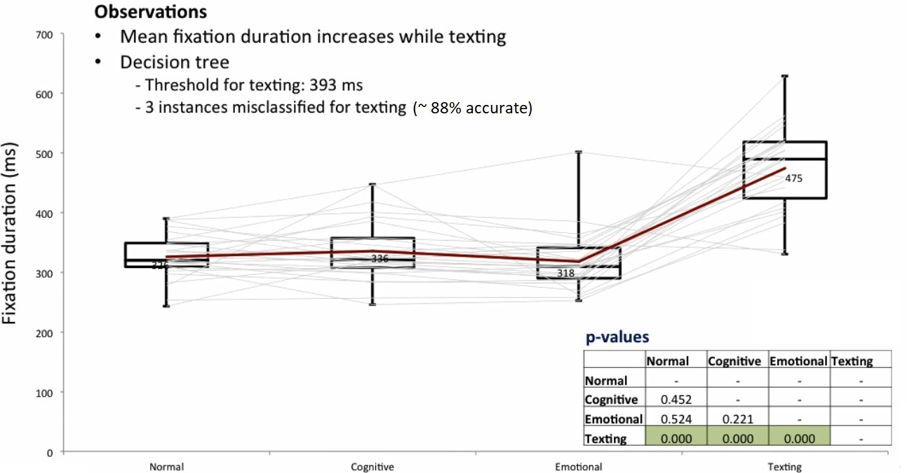
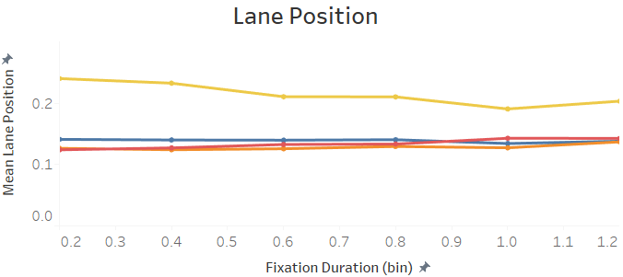
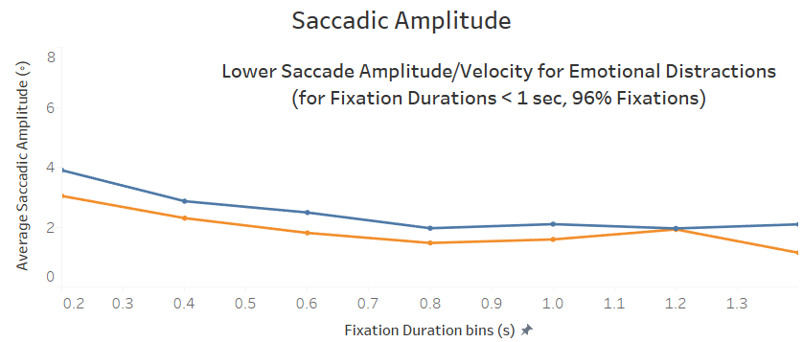
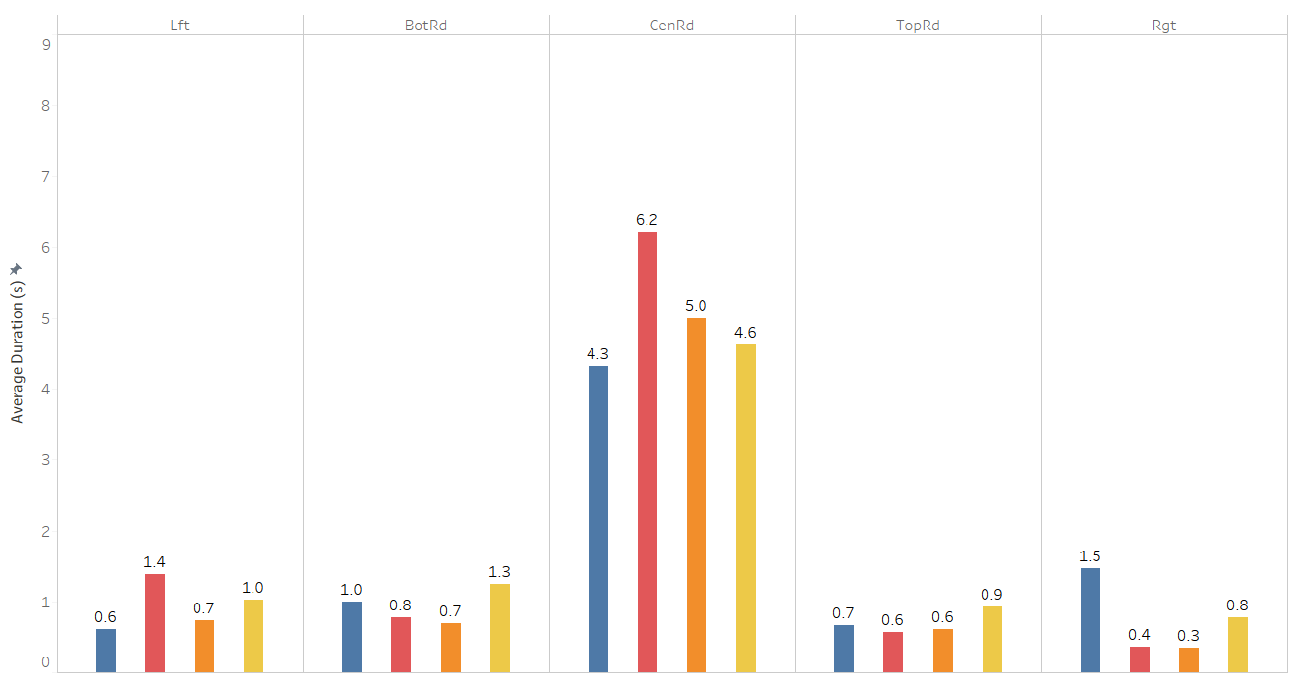
Conclusions (1/3)
Texting causes
decrease in number of fixation counts and increase in fixation durations
significant lane departures
Cognitive and emotional distractions
restrictive eye movements
increase AOI dwell times at road (44% for cognitive, 16% for emotional)

Slide 44
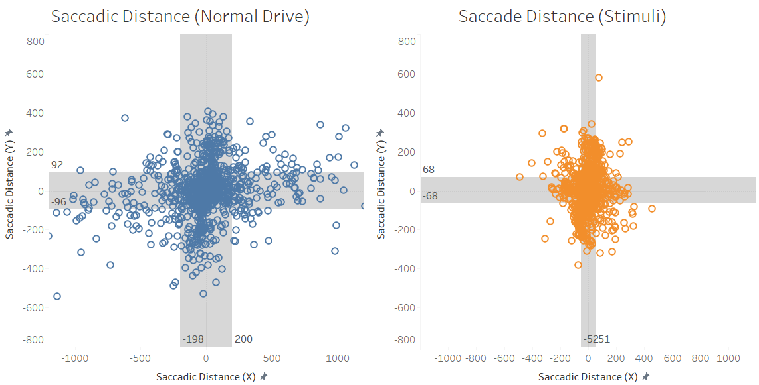
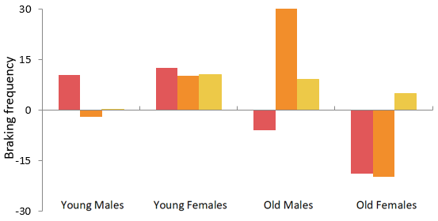
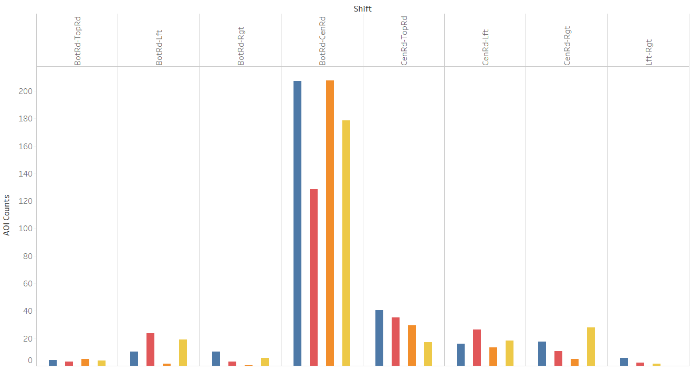
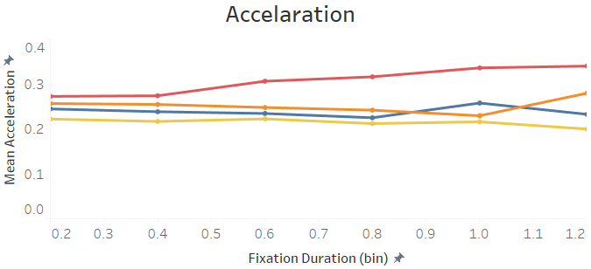
Conclusions (2/3)
Emotional distractions
reduce horizontal eye movements (~50%), showing much higher reductions in older drivers
cause older males to apply brakes frequently
Cognitive distractions
show decrease in AOI shifts (38%)
cause young females to accelerate

Slide 45

Conclusions (3/3)
Males show significant difference in distributions for fixation and saccade duration under emotional and cognitive distractions
There is a significant increase in absolute steering movement for all distractions, which might represent dangerous driving behavior

Slide 46


Future Work
Publish the research findings at ACM CHI conference or IEEE Transactions of Affective Computing journal
Predicting the driving distractions

Slide 47





Acknowledgments
Computational Physiology Laboratory (CPL)
University of Houston
Eye Movement Analysis Package for Fixation and Saccade Detection
Author: Simon Schwab (‘emov’ package in R, Aug 2016)
Dr. Dvijesh Shastri
Associate Professor
Dr. Benjamin Soibam
Assistant Professor
Dr. John P. King
Assistant Professor
Dr. Erin M. Hodgess
Associate Professor
Dr. Ermelinda G. DeLaViña
Associate Dean

